Slide 1

COPING WITH COVID-19:
MAINTAINING YOUR MENTAL HEALTH IN A PANDEMIC

Slide 2
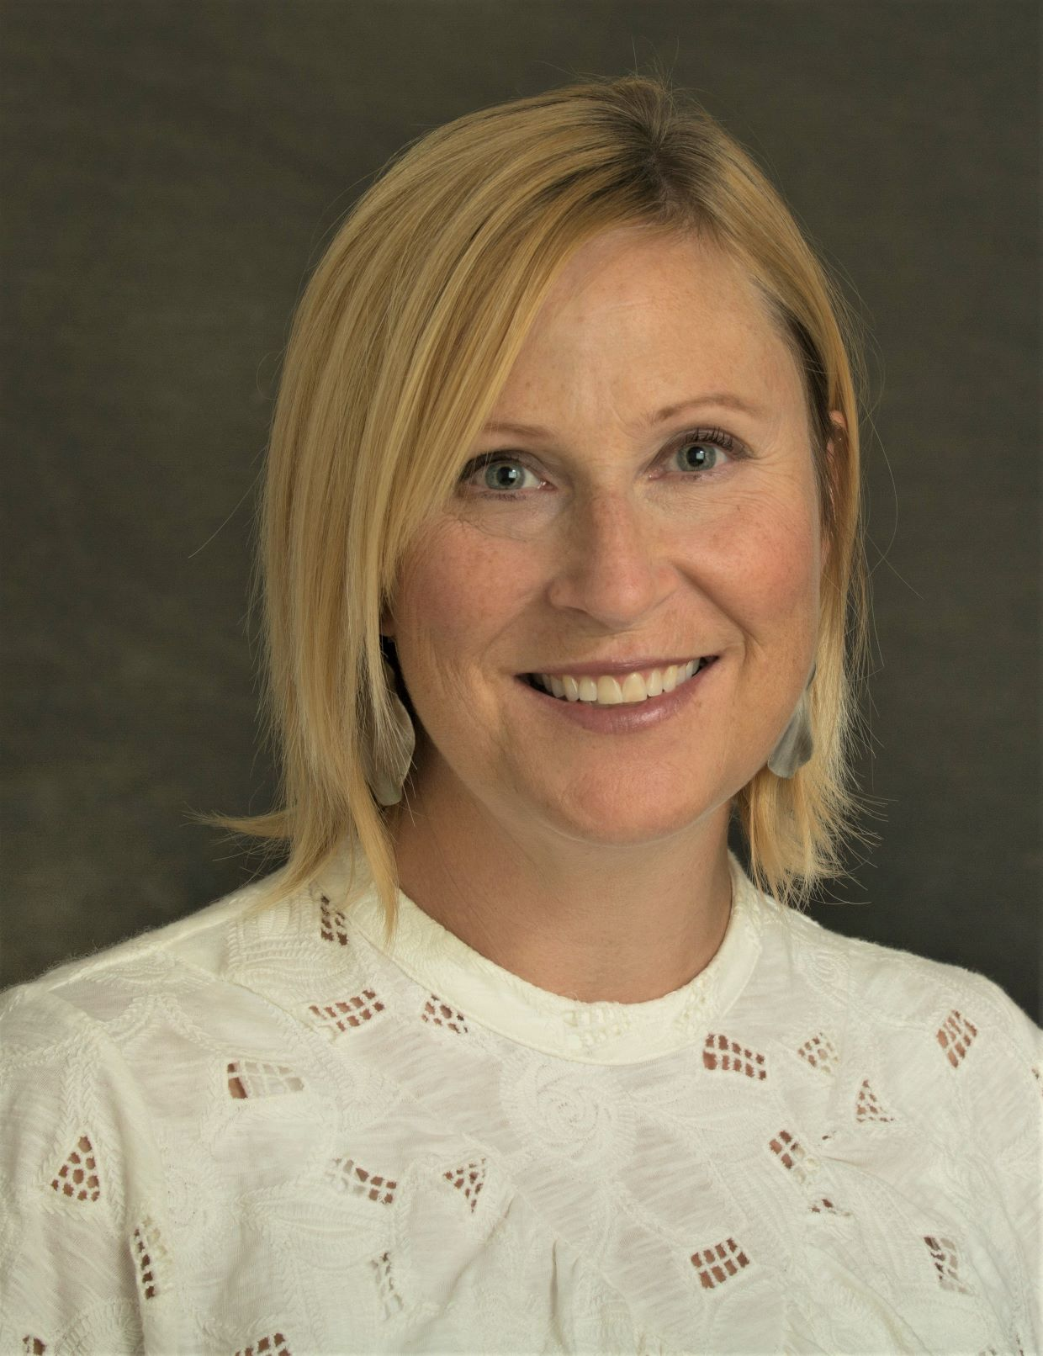
Introduction
Rebecca Morra MA, LPC
Licensed Professional Counselor
Cincinnati Counseling & Play Therapy in Blue Ash, and Child Focus
Thank you for having me

Slide 3
Goals for Today’s Presentation
You will receive:
  Resources
  Recommendations
  Real help
Ask questions as you have them
Notes:
Some of what you receive will be specific to COVID-19 Pandemic and some will be useful regardless.
I encourage you all to share with each other any additional resources and recommendations you have.

Slide 4
Resources
Share one thing
Body Scan Meditation (do together)
Covid Coach App
Building Happy Habits
Coping With Coronavirus For Adults
Top 25 Mental Health Apps for 2020
52 Ways To Reduce Stress (Handout)
The Pandemic Crisis Services Coalition
Financial Assistance
Notes:
There are millions of resources out there but these are the ones I thought would help most now.
If you have additional suggestions, please chime in!

Slide 5
Recommendations
1. Stay informed. Don’t over-indulge in news. Set limits.
  Access Gov Mike DeWine’s daily briefings on WVXU of online at:
  Ohio.gov website
  https://coronavirus.ohio.gov/
  Centers For Disease Control
  https://www.cdc.gov/coronavirus/
Notes:
**Some news sources are more reputable than others.

Slide 6
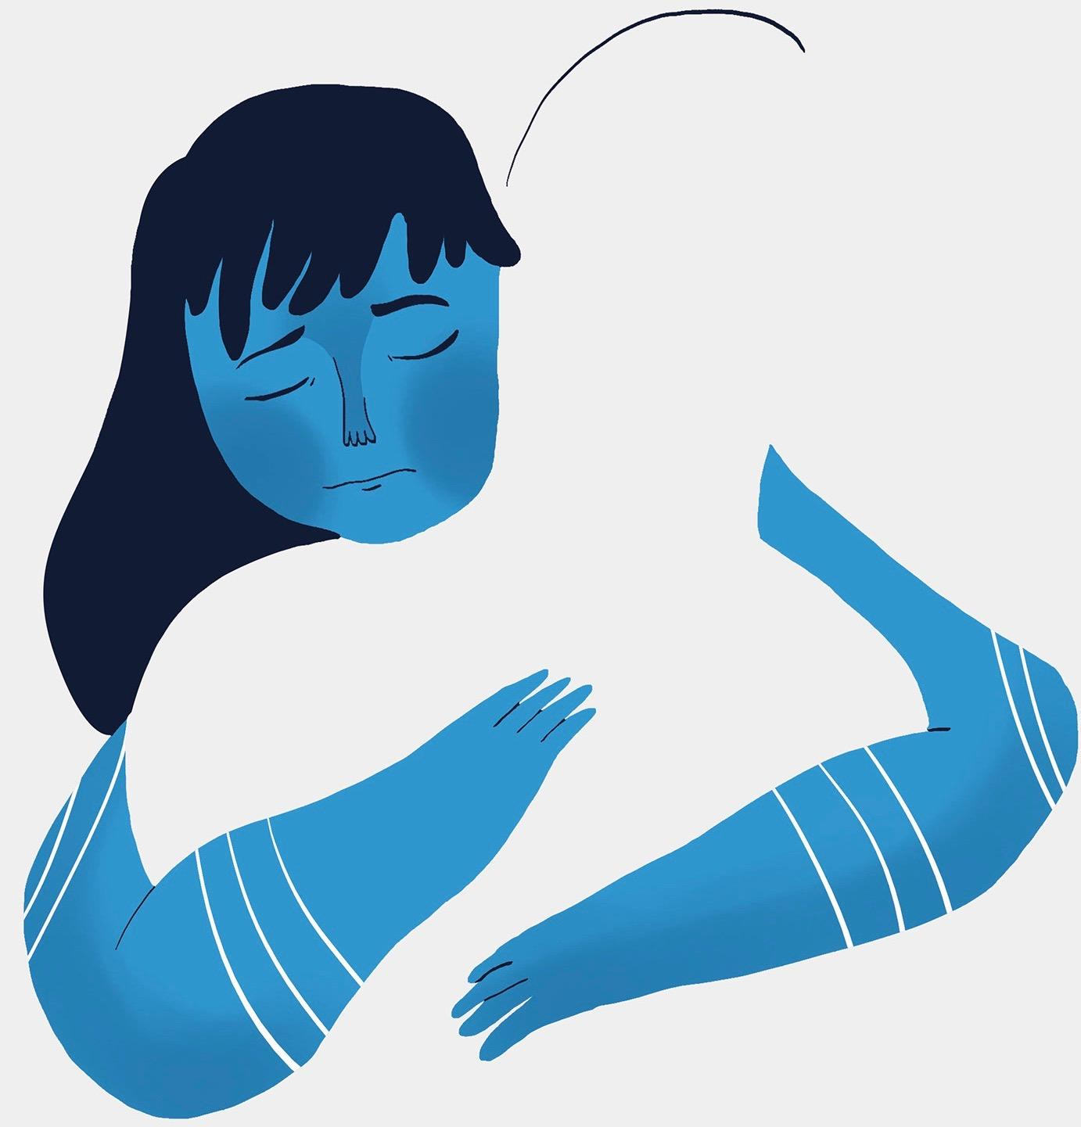
Recommendations
2. Adhere to “social connectedness, physical distancing.”
Notes:
“Social Distancing” indicates you shouldn’t socialize. But we’re hard wired for connection and we need connection—desperately. The term I’d recommend is “Social Connectedness & Physical Distancing”

Slide 7
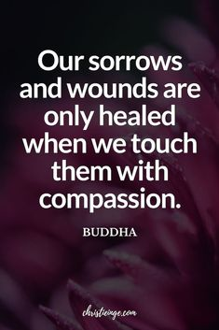
Recommendations
3. Ask yourself and your nervous system what’s best for you.
Read More.
Notes:
There’s a link to the article.

Slide 8
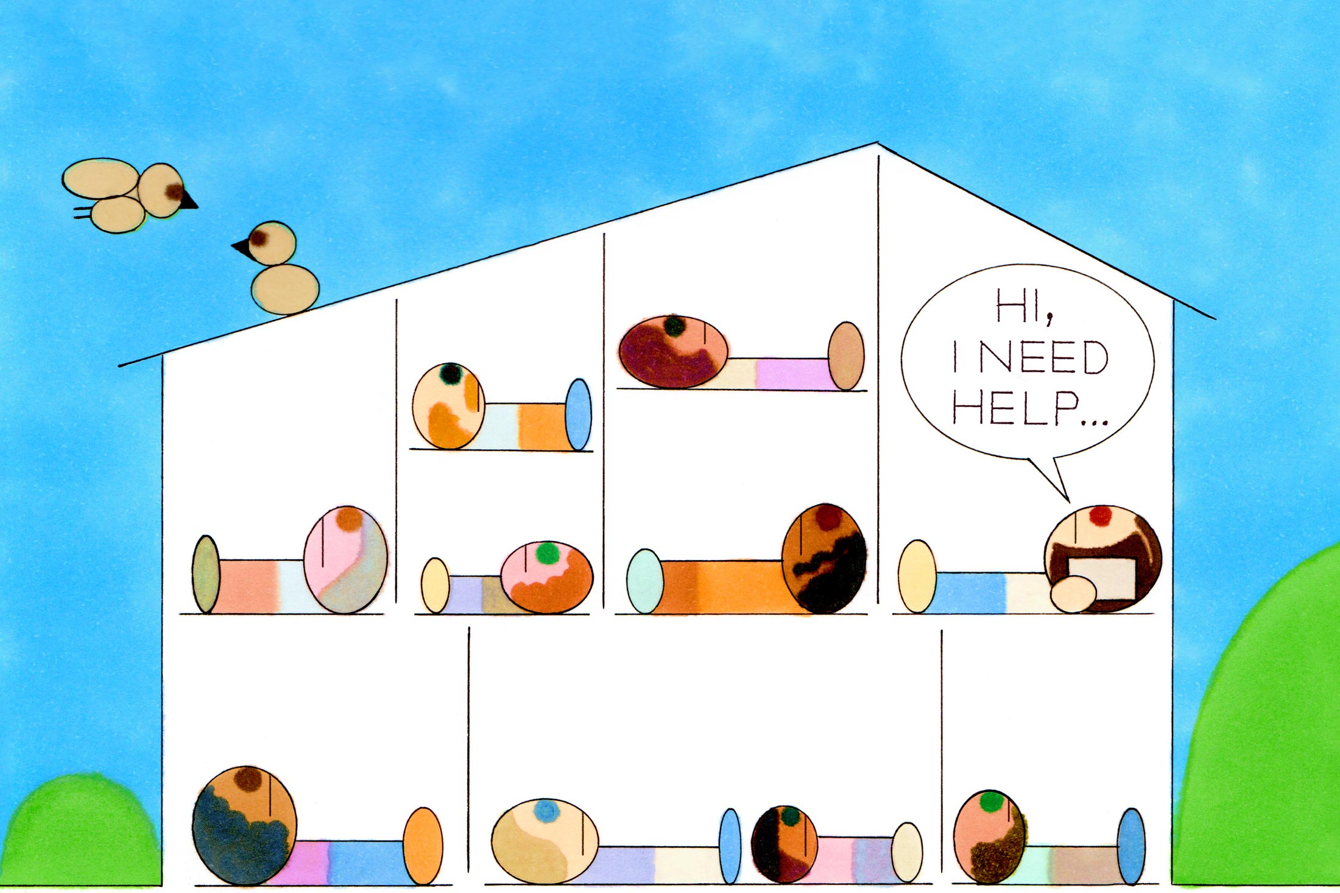
Recommendations
4. Help others if you feel inclined.
Notes:
Altruism boosts dopamine receptors in our brains. For some, it helps the giver even more than the receiver.

Slide 9
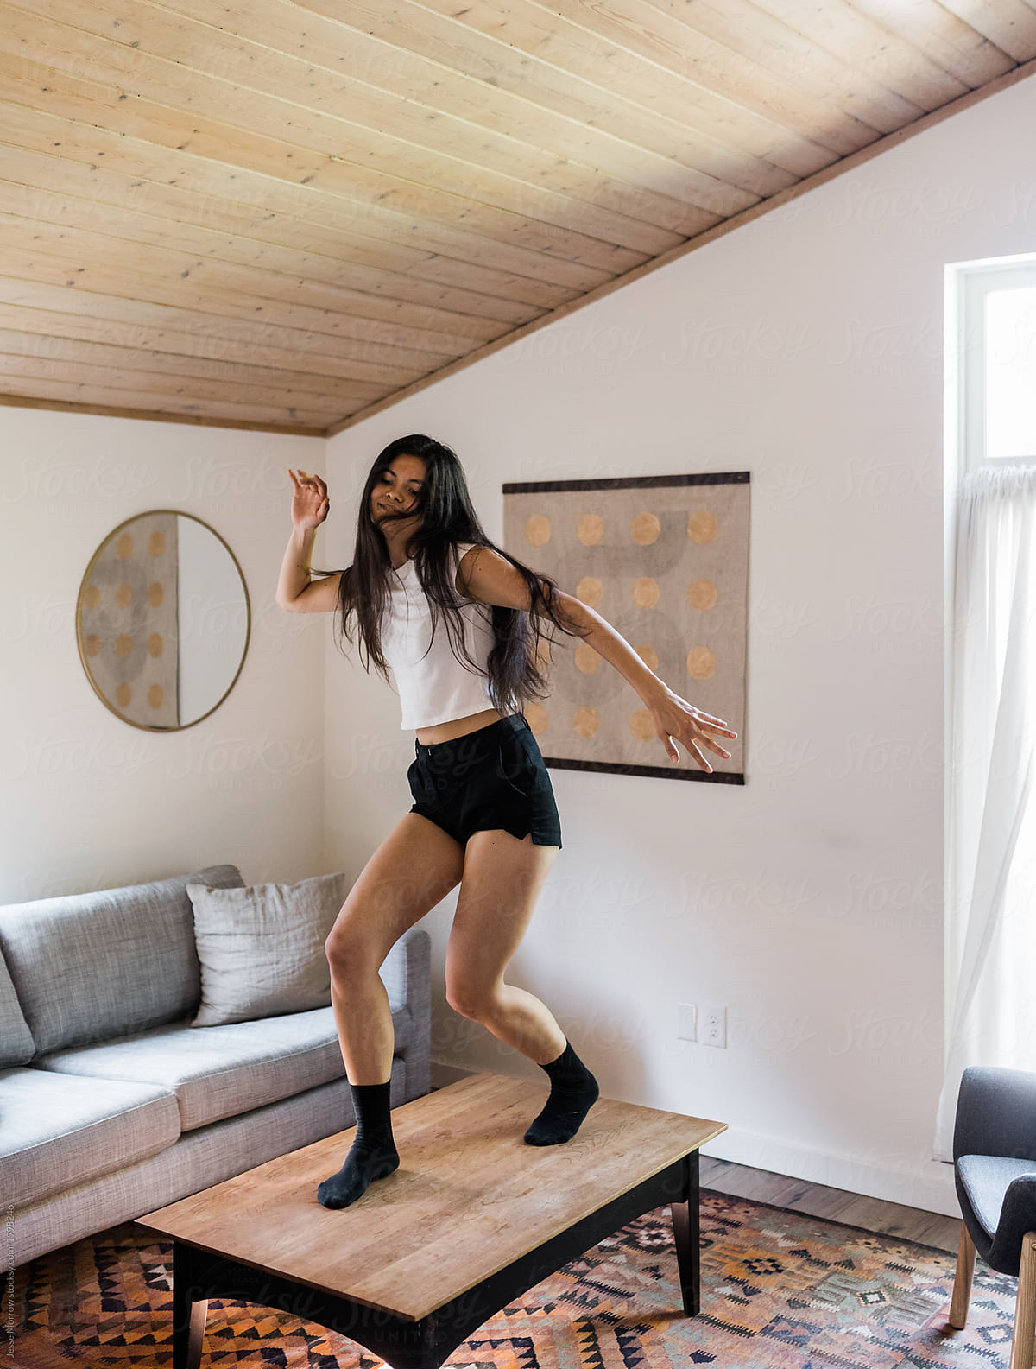
Recommendations
5. Turn on your favorite music and have a dance party in your living room.
Notes:
If you don’t like dancing to music you can clean, walk or run to music—the point is, get moving and do something you like and do it to music.

Slide 10
Recommendations
6. Eleven Sure-fire ways to go batty 😊
  1. Work really long hours….without breaks.
  2. Tackle as many difficult, challenging tasks as possible.
  3. Avoid taking time for yourself at all costs.
  4. Pay extra close attention to all news reports about COVID-19.
  5. Base your self-esteem exclusively on your work.
  6. Avoid or ignore all friends, lovers and family.
  7. Focus on the negative.
  8. Fail to recognize the ways you are making a positive difference.
  9. Refuse to let go of past mistakes and conflict.
  10. Don’t laugh at potentially humorous situations.
  11. Don’t ask for or accept help.

Slide 11
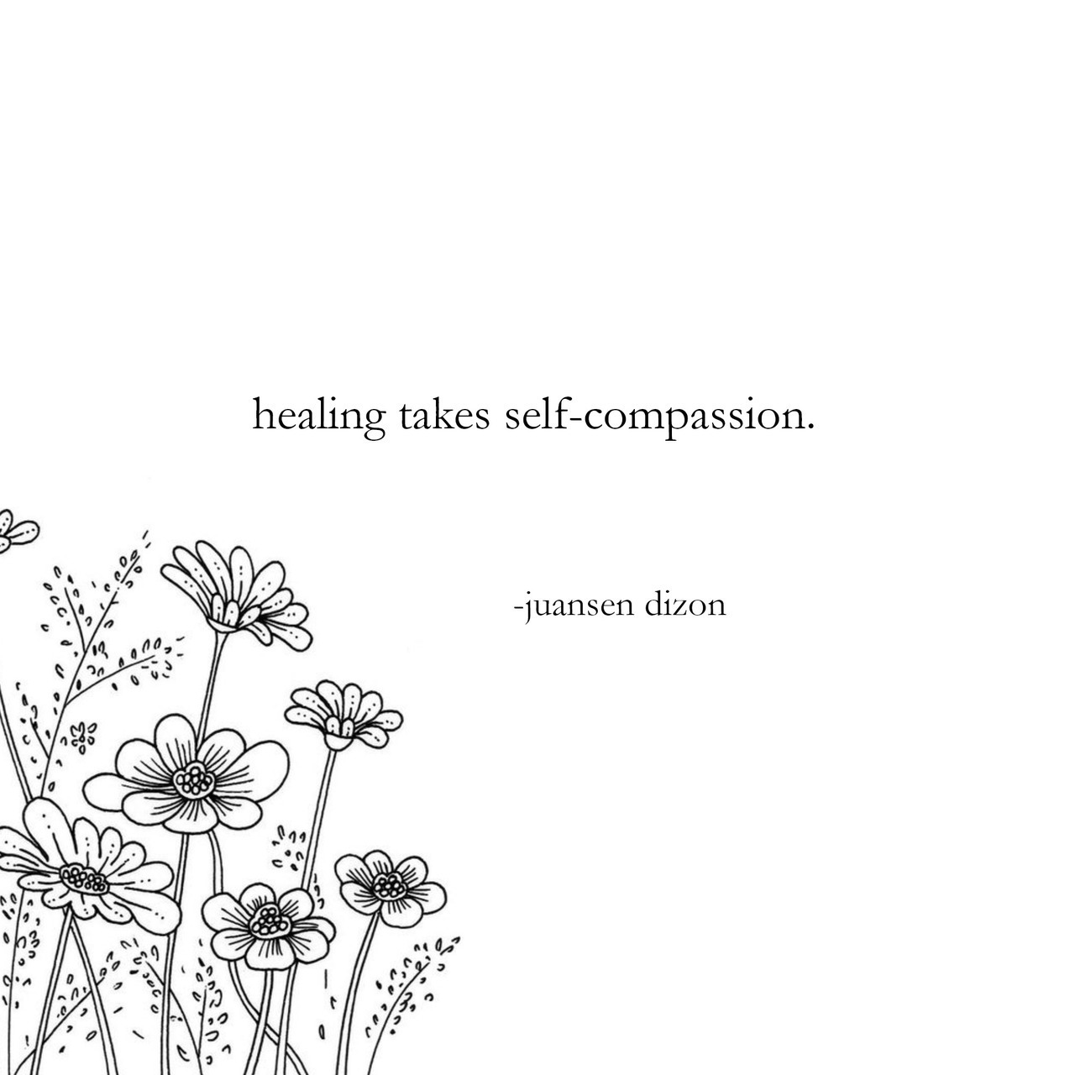
Recommendations
7. Practice Self-Compassion. Check out the work of Dr. Kristin Neff at https://self-compassion.org/

Slide 12
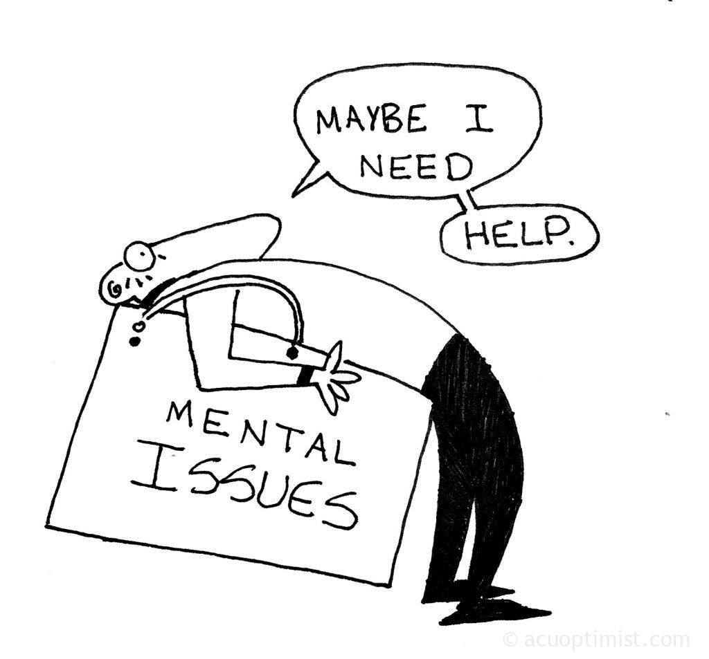
Real Help
Seek the help of a therapist if need be.
All people, regardless of issues, could benefit from therapy.
Nearly all therapists provide videochat or phone therapy and soon will offer in-person therapy again.
Some offer low-cost services due to so many people being out of work.

Slide 13
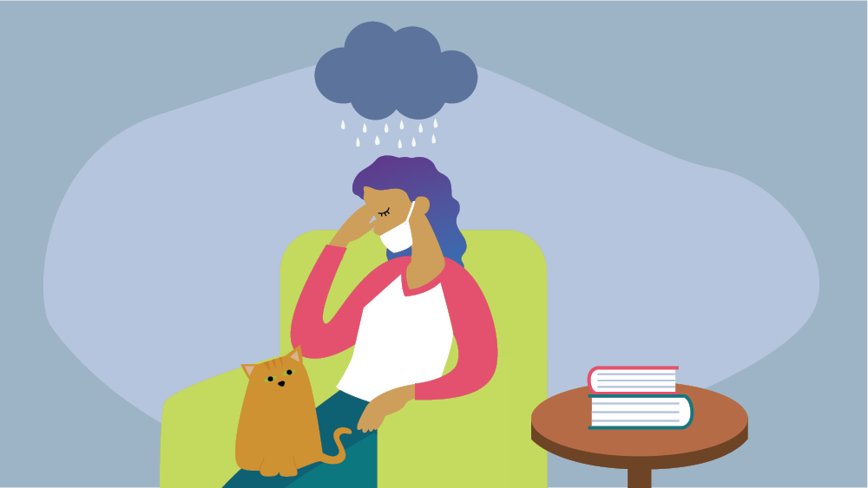
Real Help
To find a therapist:
Ask your primary care physician for referrals
Go to www.psychologytoday.com or www.goodtherapy.org
Ask friends and family for recommendations
Contact me
Notes:
Search function on psyc and good therapy—filter results

Slide 14
Reach Out for Help
Cincinnati Counseling and Play Therapy in Blue Ash
Accepting new clients (kids through older adulthood)
4424 Carver Woods Dr. Suite 100
Blue Ash 45242
cincinnaticpt.com
Rebecca Morra MA, LPC
513-399-6794
rebeccca@cincinnaticpt.com

Slide 15
Share 1 Thing or Questions?
What’s one thing you learned, plan to use or gained as a result of today’s conversation?
Any questions?

Slide 16
Thank You
Thank you for sharing yourselves and your stories.
Please be good to yourself.
Know that you are not alone. You have my support.
Continue to take care of each other and yourselves.

